Slide 1
Movie recommendations system.
SWARM & EVOLUTIONARY COMPUTING
projects
Subimtted to:
submitted to: om nath kushwaha
2k18/co/409

Slide 2
Introduction:
Recommendation systems produce a ranked list of items on which a user might be interested, in the context of his current choice of an item.
Subclass of Information filtering system that seek to predict the rating or preference" that a user would give to them.
Helps deciding in what to wear, what to buy, what stocks to purchase etc
Applied in variety of applications like movies, books, research articles, Recommendation systems has mainly two elements Item and User.

Slide 3
Types of Movie recommendation system:
Content Based: The recommendation system recommends other movies which are similar to that selected movie. f(movie) => {movies)
Collaborative: The recommendation system recommends movies which are rated highly by the similar users. f(movies, user) => (movies)
In this projects we will discuss about Content Based recommendation systems:

Slide 4
Datasets used:
We have used Movie Dataset downloaded from kaggle This data set consists of: 5000 movies list with different attributes like, their, name, popularity, budget, etcs.
This datasets only consists of movie upto 2014.

Slide 5
Data preprocessing
Since the movie datasets still consists of unwanted columns which are no longer needed so droping unwanted columns.
We have dropped the columns like budgets, homepage, id, keywords, original_languages, production etc.
Dropping duplicates movies if there are any.

Slide 6
Methodologies:
Content based filtering:
It uses only the item data maintaining a profile for each item. Each user is assumed to operate independently. No need for data on other users.
Considering the attributes or feature of the items, it finds the similarity between items, and recommends the most similar item for an item
If we consider the content of a movie as director, writer, cast etc., then each of these attribute can be considered as a feature.

Slide 7
Experimentation
We recommend the items to the users which are very much similar to the rated item by the user.
we have used Term frequency and inverse document frequency techniques to create vectors.
TF=No. of repetition of words/No of words in sentence
IDF=log(No of sentences/ No of sentences containing required word).
Final result=TF* IDF
We will use sigmoid kernel to find similarities between vectors.
Sigmoid kernel will compare the one movies with indexes of other movies in matrix and return those movies which have some similar characters.

Slide 8
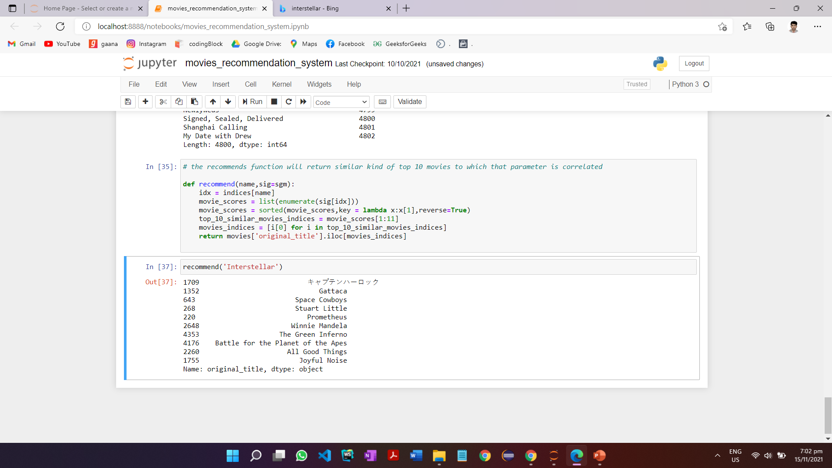
Results: we can see that the model will recommend the similar kinds of movies as shown in fig: when we watch the movies named interstellar the model will recommend the similar types of space related movies to which its parameter is correlated.

Slide 9
Future work:
In this project we have built the model for recommending the similar types of movies.
Our future works would be to focus on building the user interface and to visualize the movies recommended with its pictures and artists details as well.
we will be using react.js for building frontend user interface and databases we are using mongodb. We will feed the recommended movies to fronted to view the movies right in web browsers.
This type of technology are used by different video streaming platforms like Netflix, prime video’s etcs to recommend movies to its users.

Slide 10
References
https://www.kaggle.com/rounakbanik/the-movies-dataset
https://ijesc.org/upload/f0d1e3f5683da81c9018ff3308495420.A%20Movie%20Recommender%20System%20MOVREC%20using%20Machine%20Learning%20Techniques.pdf

